Slide 1

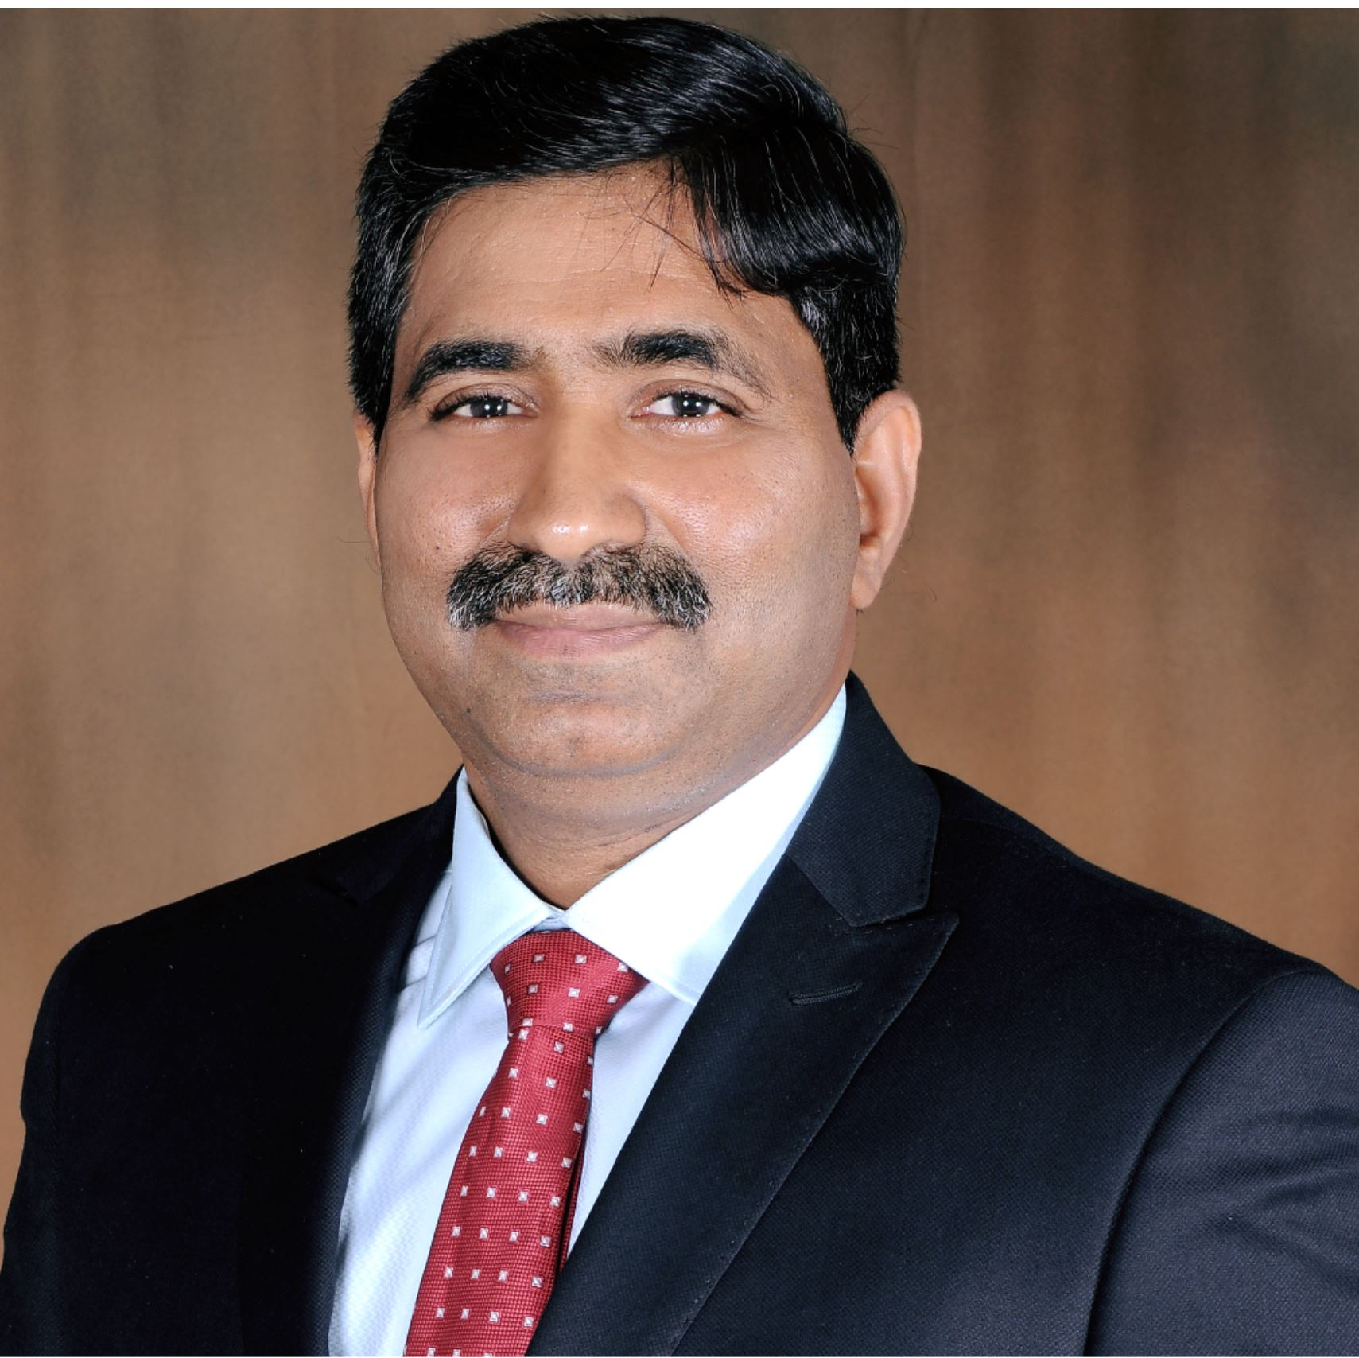
One Swag
Syed Mazhar
Ramalingam Kothandam

Slide 2
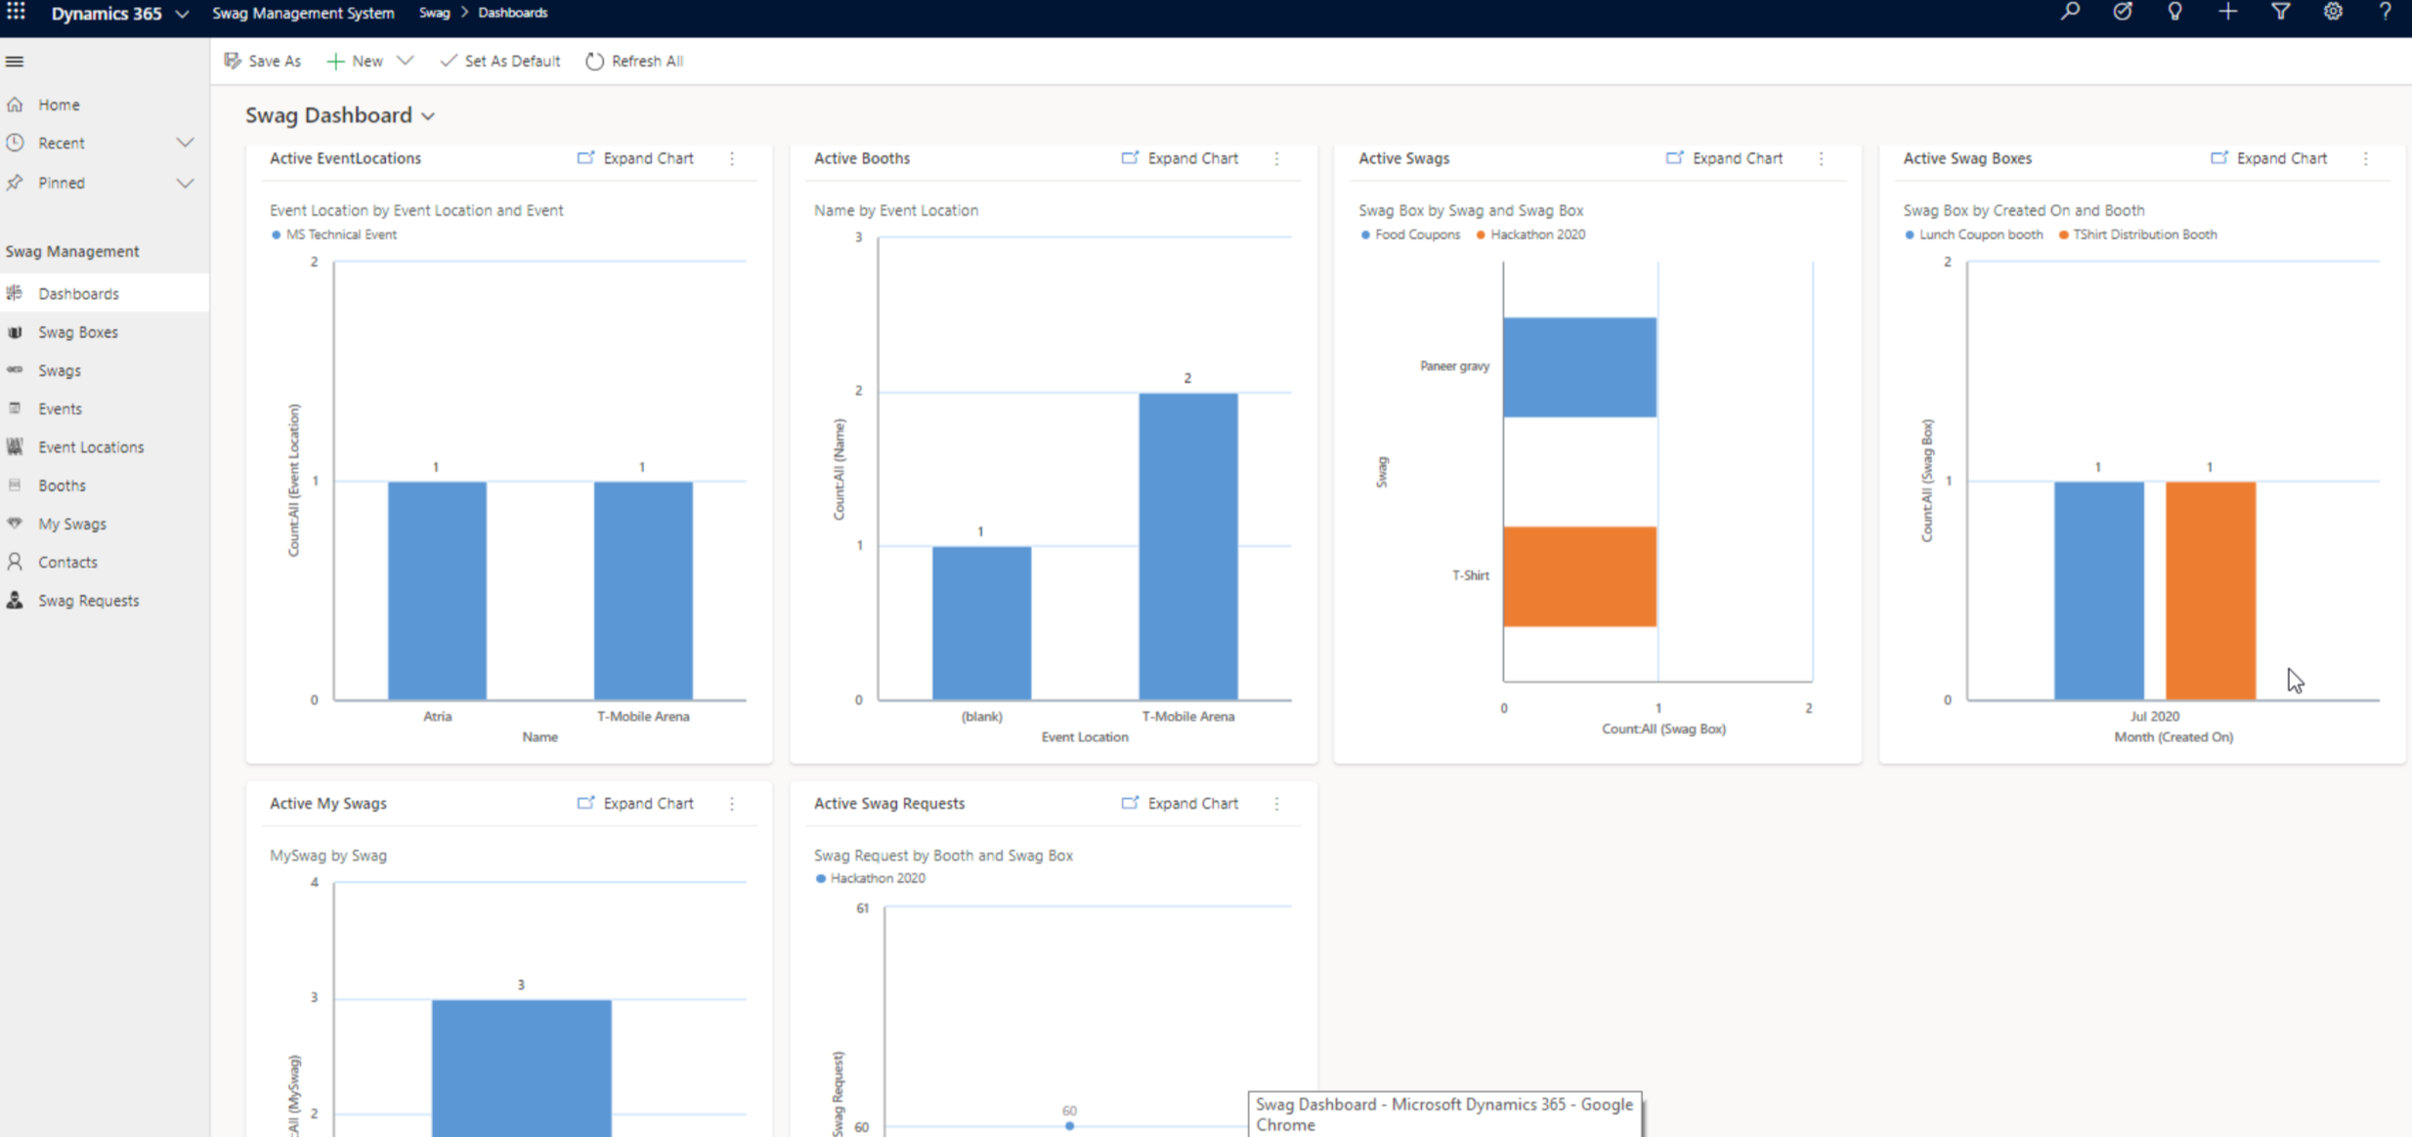
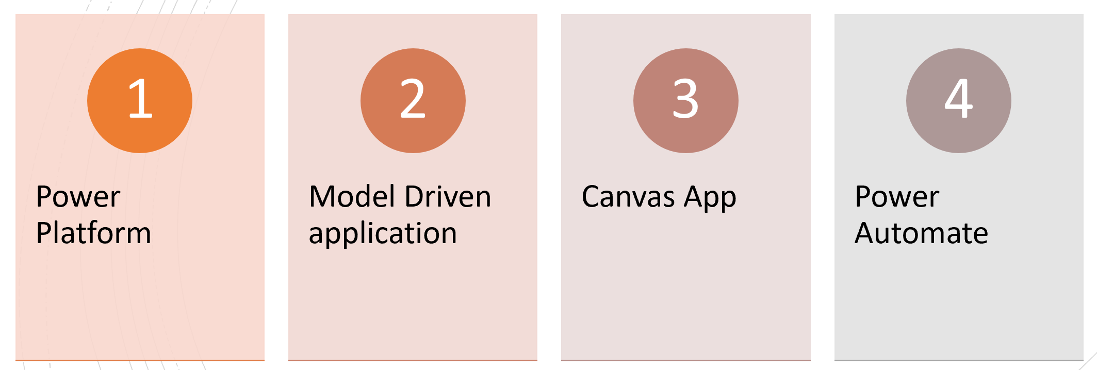
What is One Swag…?
Swag Management System
Technologies Leveraged
Power Platform
Model Driven Application
Canvas App
Power Automate

Slide 3
Why “One Swag”
1000’s of Events across the Globe
Unorganized data
Great opportunity to roll-out Dynamics 365 quickly and increase ACR
Potential to up-sell other products
Ability to support “Remote Working”
Centralized
History
Analysis

Slide 4

Who needs “OneSwag”…?
Events
B2B
B2C
Internal Team
Onboarding of Resources

Slide 5
Features Supported
Plan Swag Distribution in Mega or Virtual Events
Booth Management
Plan, Prepare, Design Swag Boxes
Swag Management
Swag Tracking
End User Visibility on Swag

Slide 6
Where to Find
https://garagehackbox.azurewebsites.net/hackathons/2107/projects/91177
https://github.com/amrullah08/swagmanagement

Slide 7
Ready to Use Application
Swag Management System – Model Driven Application developed with no code approach.
Swag Tracker – Canvas Application developed for end users to see swags assigned and provide additional information for swag processing

Slide 8
Swag process flow
Create Swag Box
View Swag Box
Fill the Box
Distribution
Setup Booths and Owners

Slide 9
Installation
https://garagehackbox.azurewebsites.net/hackathons/2107/projects/91177
https://github.com/amrullah08/swagmanagement

Slide 10
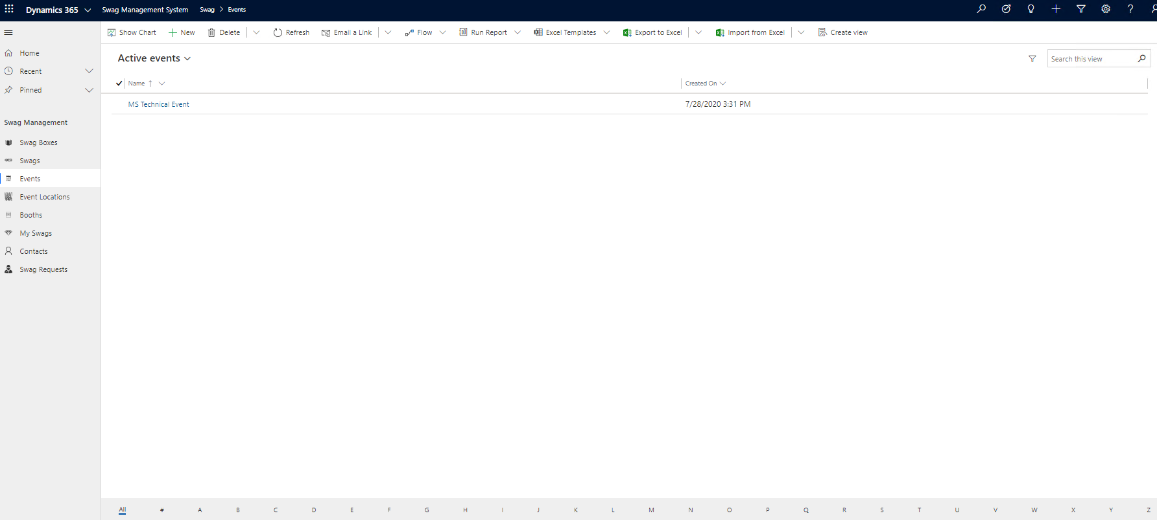
Glimpse of Swag Management System

Slide 11
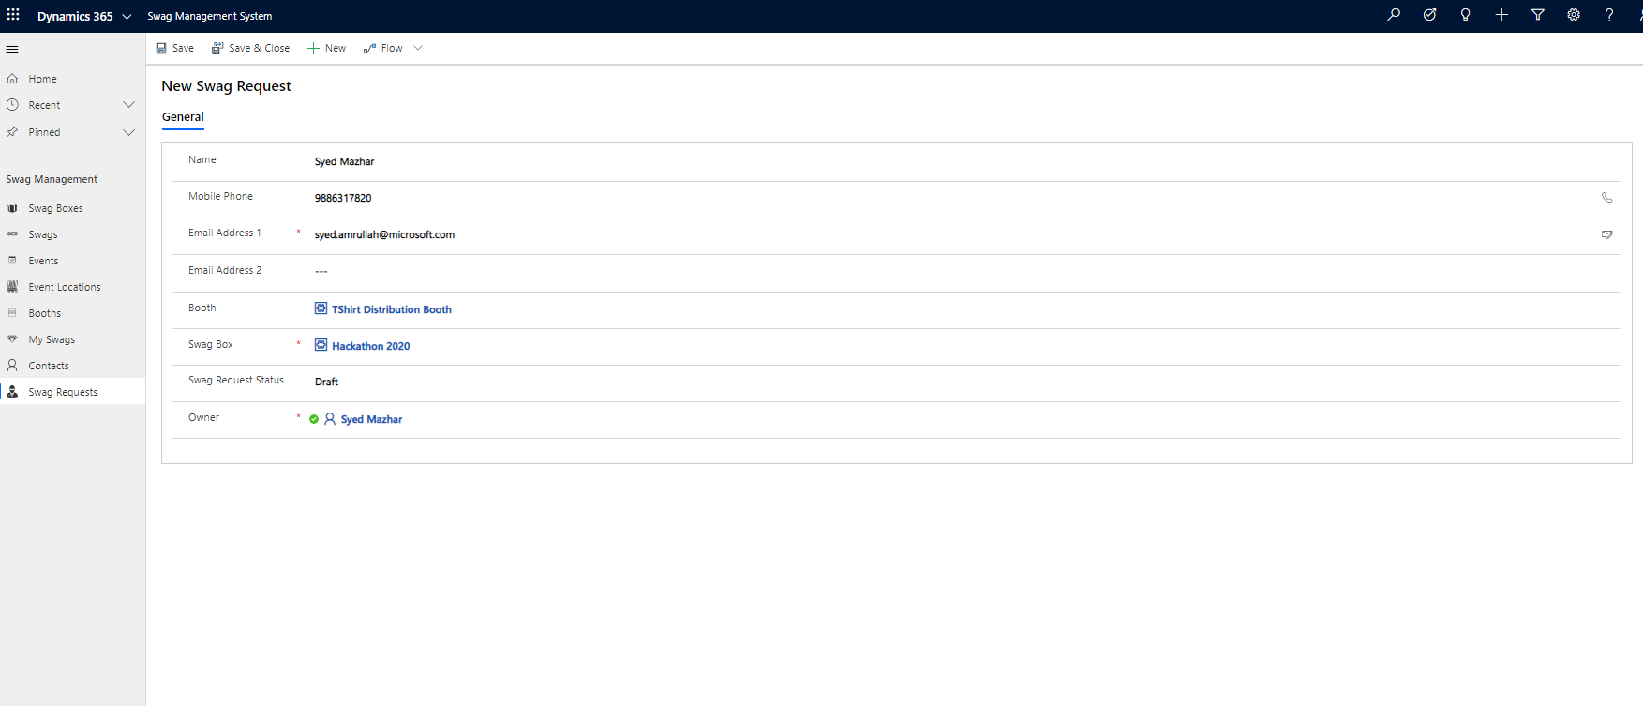
Distribute Swag From Booth

Slide 12
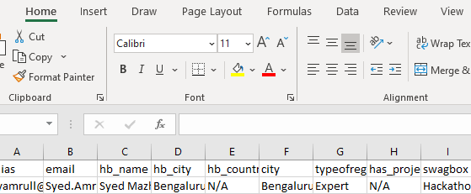
Distribute Swags using Power of Excel

Slide 13
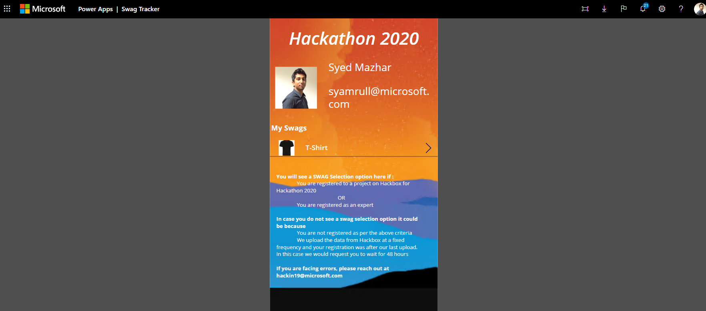
Swag Tracker – End user visibility on Swags assigned to him

Slide 14
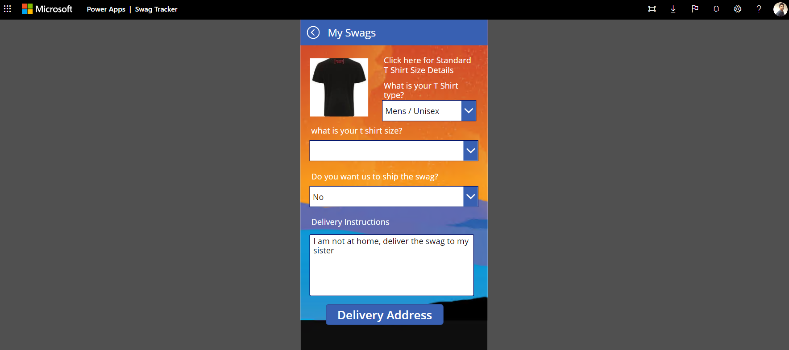
Swag Tracker – End user can update delivery information

Slide 15
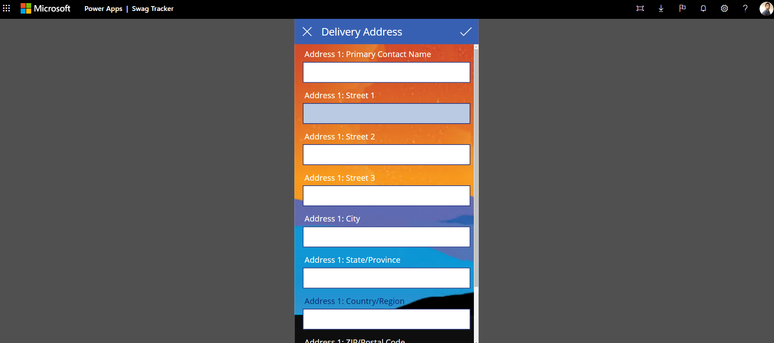
Swag Tracker

Slide 16
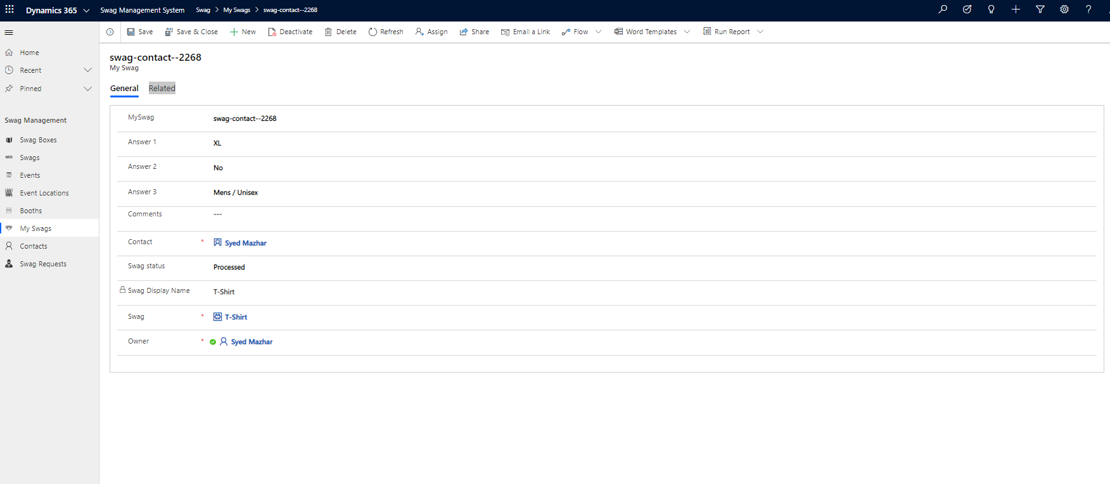
Swag status – View status of Swags

Slide 17
What is next…?
InProgress on ISV certification
01
Making it available in AppSource for entire Power Platform,MyHub
02

Slide 18
Product Roadmap
Geo-location tagging
Nearest booth to pickup goodies
Id Card detection and automatic request creation
Print the label of the address
integration with registration portal
Business card reader integration

Slide 19
Known issues
Minimize CRM onboarding time

Slide 20
Questions?

